Slide 1
Unsupervised: Clustering and Association
-LKM

Slide 2
Course Agenda :
1
Introduction - Cluster
2
K-Means
3
Hierarchical Clustering
5
Diagnostics & Advantages and Disadvantages
6
Market Basket Analysis
7
Apriori algorithm application
8
End
Notes:
Key Message(s):
Review the Agenda.
Additional Information:
This is just a brief reminder of where you are in the course. It will also help participants to know what is coming up.

Slide 3
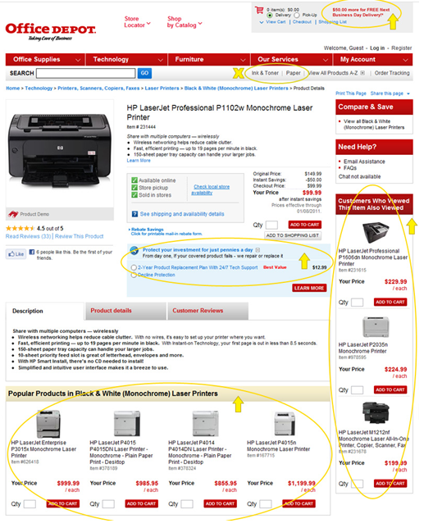
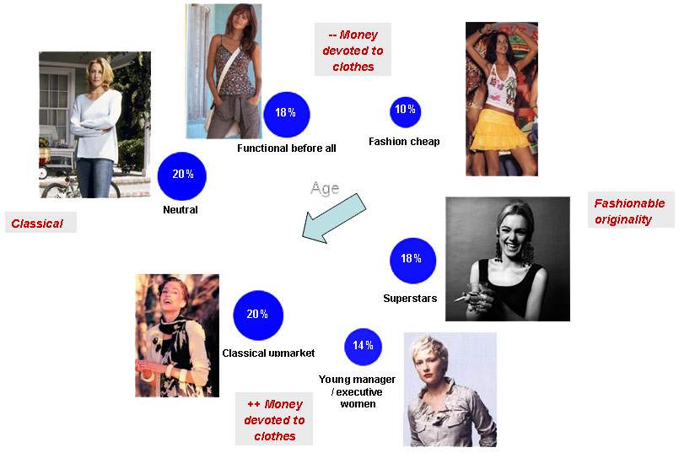
Unsupervised Learning
Fashion House Customer Groups For Promo
Cross Sell & Upsell

Slide 4
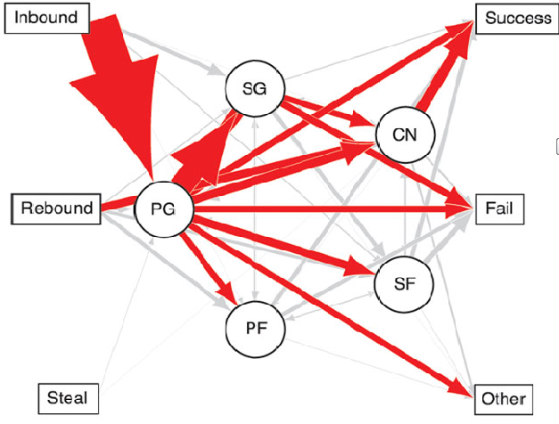
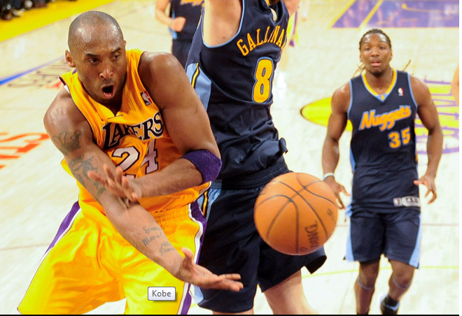
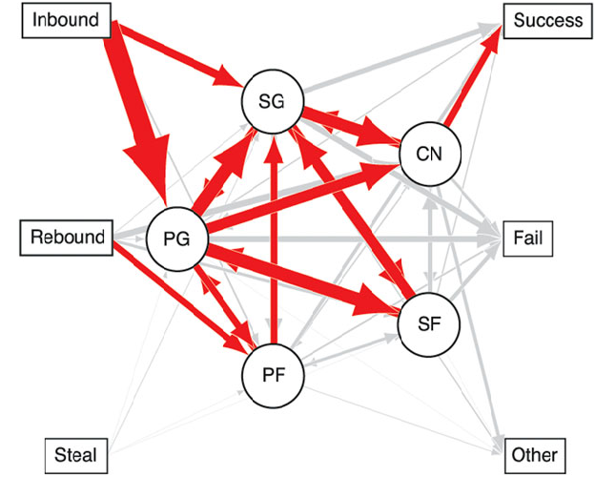
Unsupervised Learning …Contd.
Basketball Isn’t a Sport. It’s a Statistical Network
Network analysis of the Los Angeles Lakers shows the team is far more likely to distribute the ball among more players
Los Angeles Lakers WON
Network analysis of the Chicago Bulls, showing the majority of ball interaction remained with the point guard
Notes:
basketball is much more dynamic, and ball movement becomes a key variable in success. Passing is one of the fundamentals of hoops, and in the upper ranks of the sport, turnovers — often the result of wayward passes — contribute to ticks in the win-loss column. Fast, agile passing can make or break a team.
To analyze basketball plays, Fewell and Armbruster used a technique called network analysis, which turns teammates into nodes and exchanges — passes — into paths. From there, they created a flowchart of sorts that showed ball movement, mapping game progression pass by pass: Every time one player sent the ball to another, the flowchart lines accumulated, creating larger and larger and arrows.
Fewell and Armbruster’s team mapped the ball movement of every play. Using the most frequent transactions — the inbound pass to shot-on-basket — they analyzed the typical paths the ball took around the court.
For most teams, the inbound pass went primarily to the point guard, generally a team’s best ball handler. But point guard-centric, such as the Bulls, didn’t fare well in the 2010 playoffs, the researchers told Wired.
On the other hand, the Los Angeles Lakers — which won the 2010 NBA championship — distributed the ball more evenly than their rivals, embracing what Phil Jackson calls the “triangle offense,” a technique pioneered by Hall of Fame coach Sam Barry. The basic idea is simple: Maintain balanced court spacing so any player can pass to another at any point.

Slide 5
Applications of Clustering
Example on Telco – Social Network
Improve Retention of “Leaders”
Capability | Marketing Action | Benefit
Identify highly connected “Leaders” within customer base. | Target retention strategies to “Leaders”. | More efficient targeting of marketing spend. Reduced attrition / improved retention. Communications rapidly spread throughout the customer base.
Leader
0
1
2
7
4
6
3
5
10
11
8
9
14
12
13
15
16

Slide 6
Possible Applications
Clustering algorithms can be applied in many fields, for instance:
Marketing: finding groups of customers with similar behavior given a large database of customer data containing their properties and past buying records
Biology: classification of plants and animals given their features;
Libraries: book ordering
Insurance: identifying groups of motor insurance policy holders with a high average claim cost; identifying frauds;
City-planning: identifying groups of houses according to their house type, value and geographical location;

Slide 7
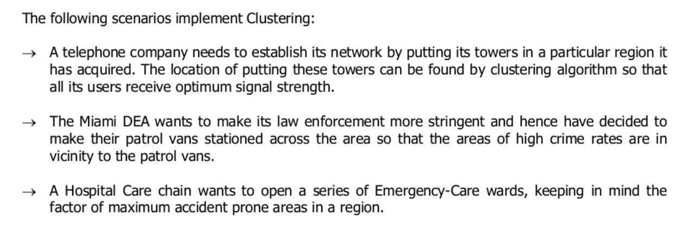
Applications of Clustering

Slide 8
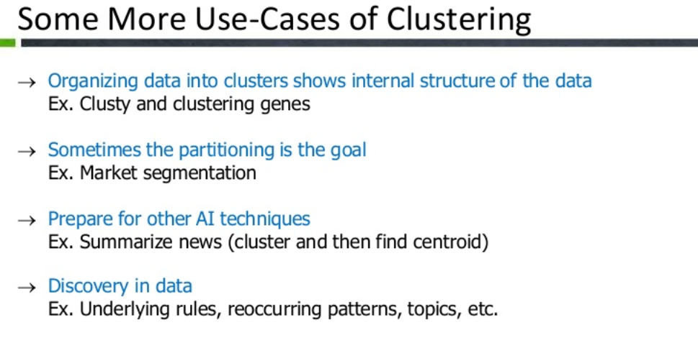

Slide 9
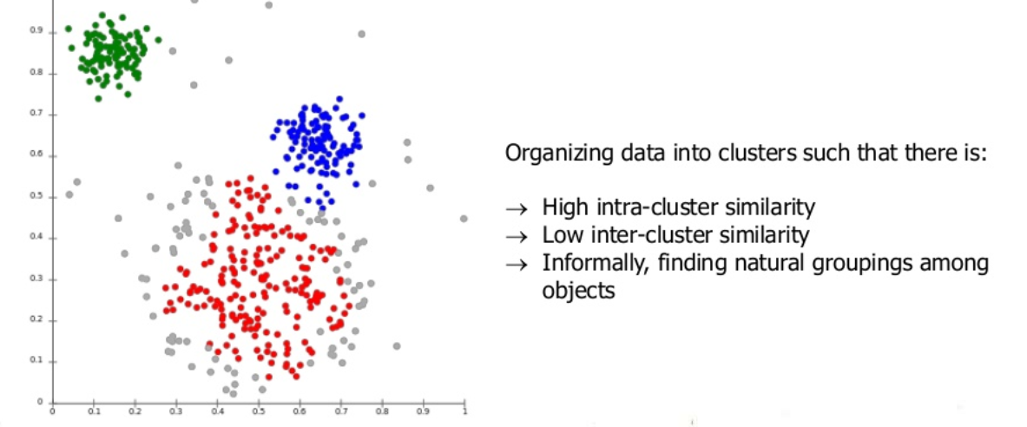
What is Clustering?

Slide 10
Algorithms
K-Means, Hierarchical

Slide 11
Types of Clustering Algorithmn
There are many forms of this, though the main form of unsupervised machine learning is clustering. Within clustering, you have "flat" clustering or "hierarchical" clustering.
Flat Clustering | Hierarchical
Flat clustering is where the scientist tells the machine how many categories to cluster the data into. | Hierarchical clustering is where the machine is allowed to decide how many clusters to create based on its own algorithms.

Slide 12
Algorithms (K- Means Clustering)
The K-Means algorithm aims to partition a set of objects, based on their attributes/features, into k clusters, where k is a predefined or user-defined constant.
The main idea is to define k centroid, one for each cluster. The centroid of a cluster is formed in such a way that it is closely related (in terms of similarity function)
Similarity can be measured by using different methods such as cosine similarity, Euclidean distance, Extended Jaccard) to all objects in that cluster.
NOTE: Use Euclidean distance to compute the distance between objects.
dist ((x, y), (a, b)) = √(x - a)² + (y - b)²

Slide 13
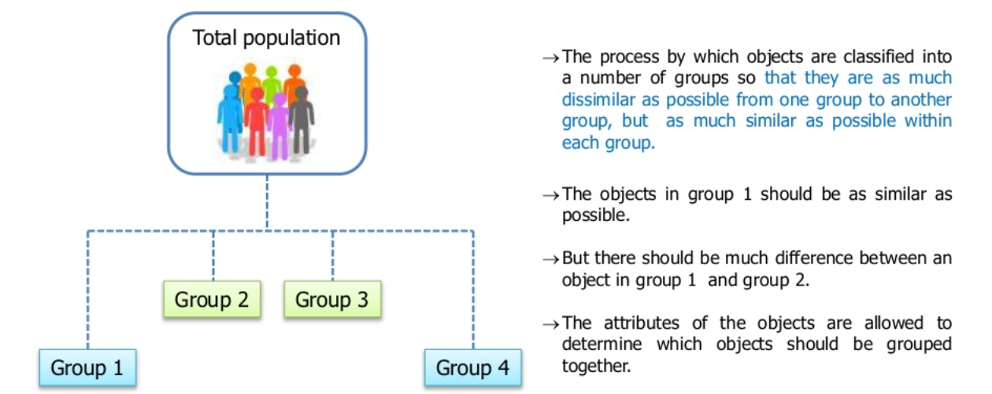
Example

Slide 14
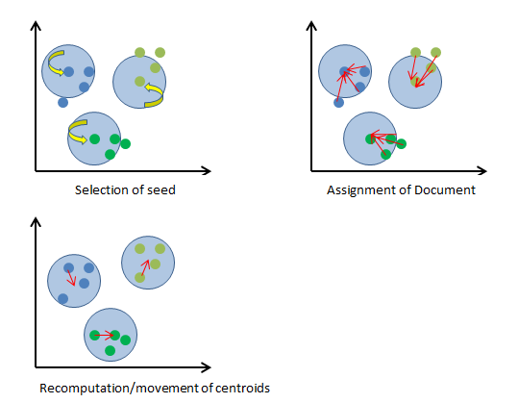
Algorithms (K- Means Clustering)
Basic K-Means Algorithm
1. Choose k number of clusters to be determined
2. Choose k objects randomly as the initial cluster center
3. Repeat
3.1. Assign each object to their closest cluster 3.2. Compute new clusters, i.e. Calculate mean points.
4. Until 4.1. No changes on cluster centers (i.e. Centroids do not change location any more) OR 4.2. No object changes its cluster

Slide 15
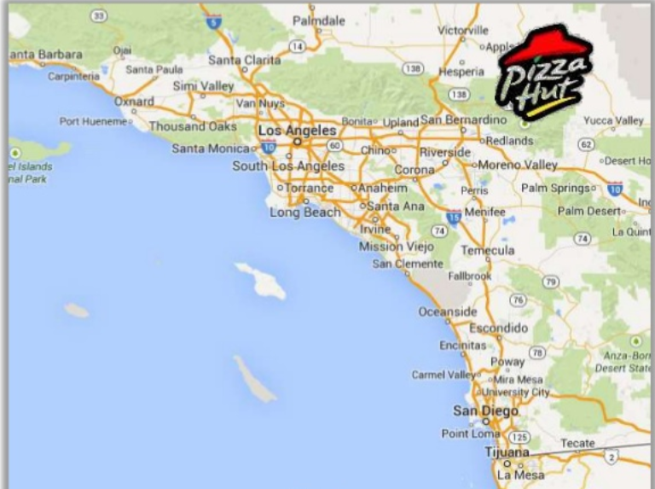
K- Means Pizza Hut Clustering Example

Slide 16
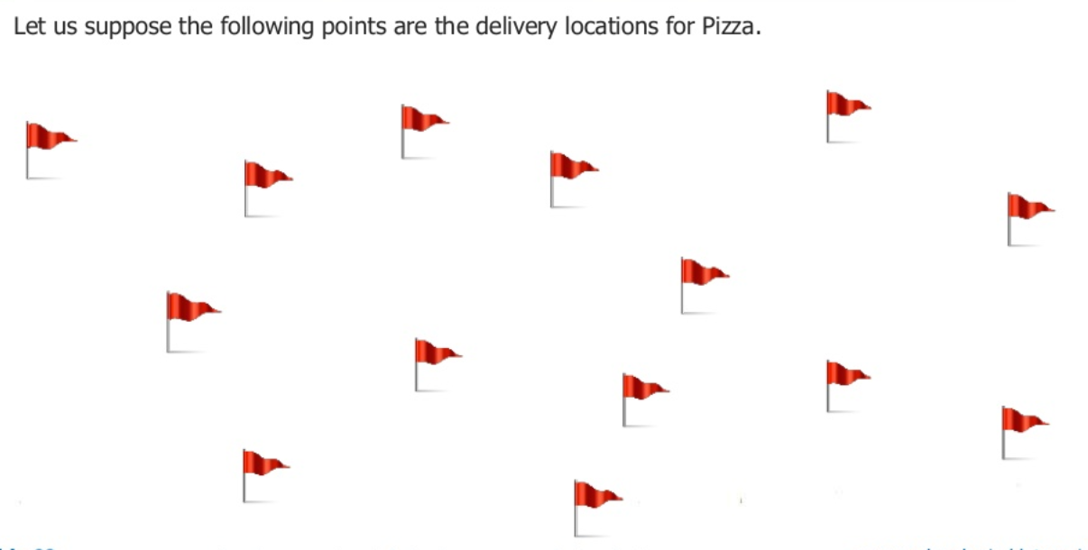
K- Means Pizza Hut Clustering Example

Slide 17
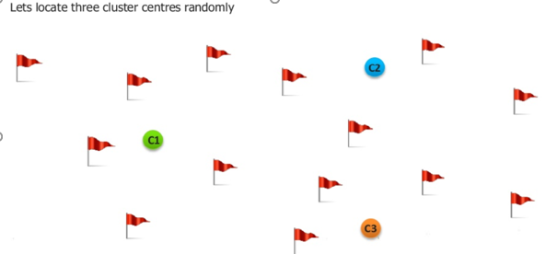
K- Means Pizza Hut Clustering Example

Slide 18
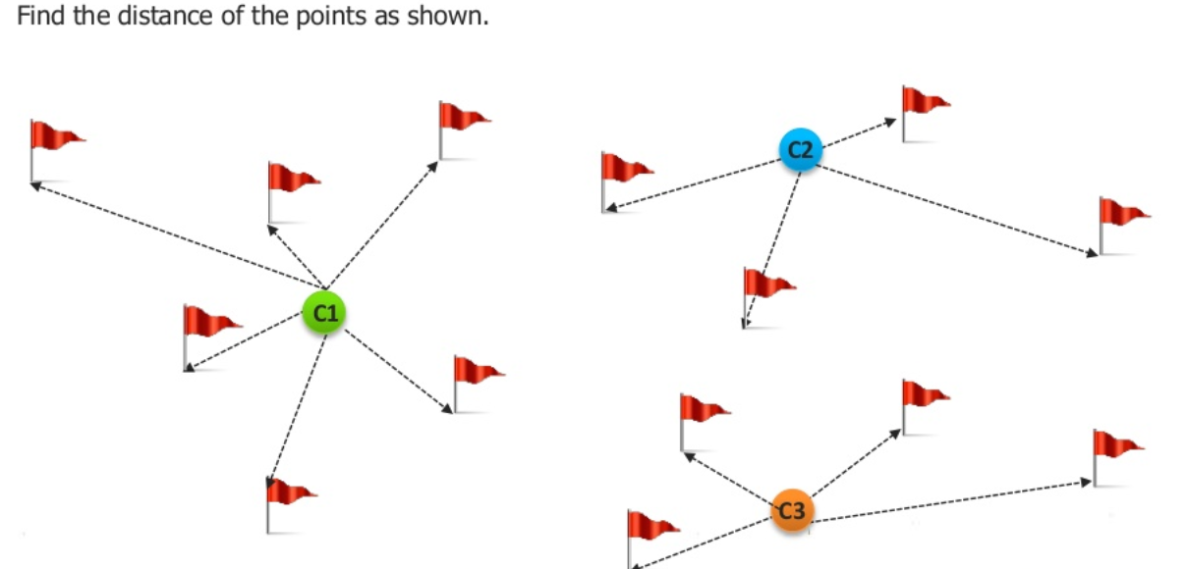
K- Means Pizza Hut Clustering Example

Slide 19
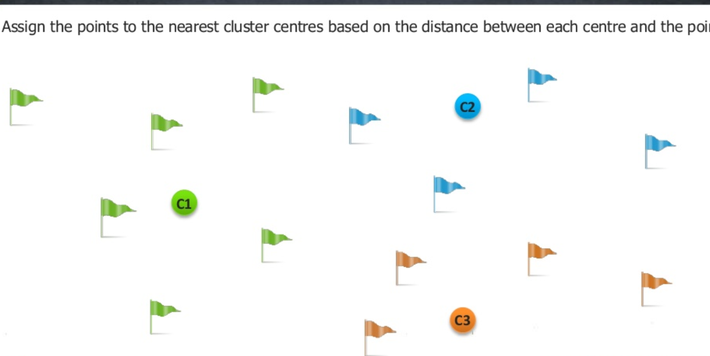
K- Means Pizza Hut Clustering Example

Slide 20
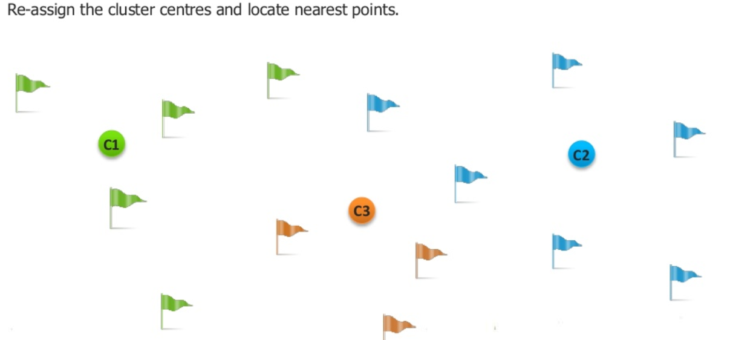
K- Means Pizza Hut Clustering Example

Slide 21
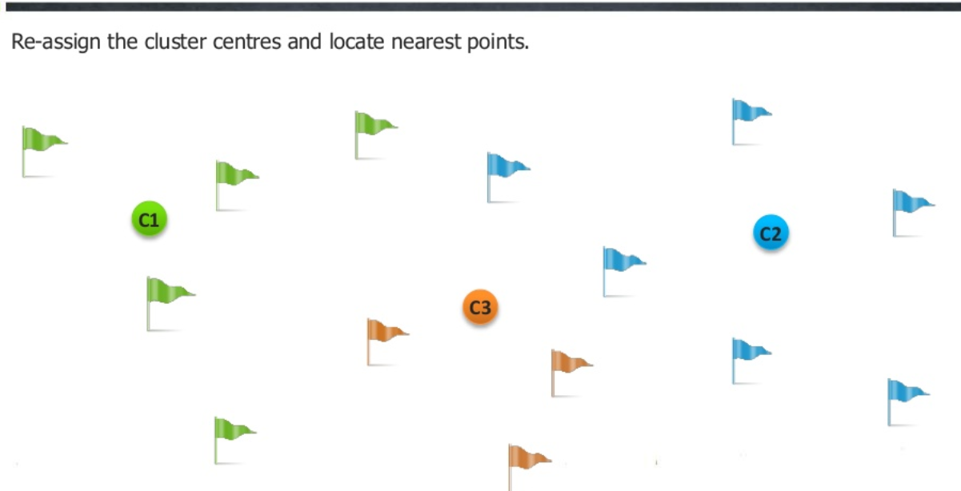
K- Means Pizza Hut Clustering Example

Slide 22
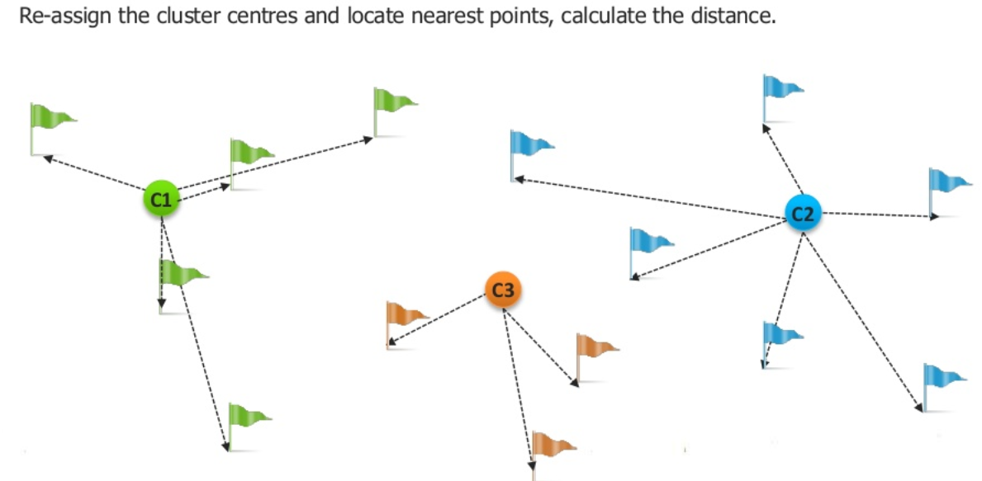
K- Means Pizza Hut Clustering Example

Slide 23
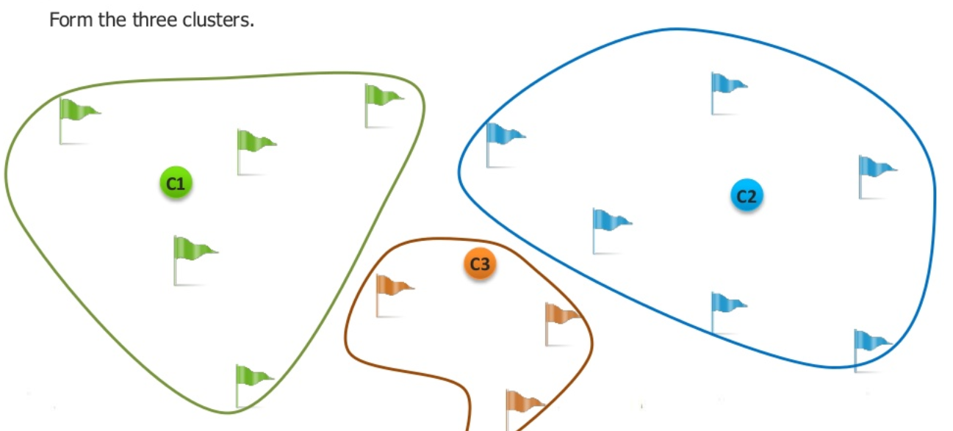
K- Means Pizza Hut Clustering Example

Slide 24
How it works ?
It accepts the number of clusters to group data into, and the dataset to cluster as input values.
It then creates the first K initial clusters (K= number of clusters needed) from the dataset by choosing K rows of data randomly from the dataset. For Example, if there are 100 rows of data in the dataset and 3 clusters need to be formed, then the first K=3 initial clusters will be created by selecting 3 records randomly from the dataset as the initial clusters. Each of the 3 initial clusters formed will have just one row of data.
The K-Means algorithm calculates the Arithmetic Mean of each cluster formed in the dataset.
The Arithmetic Mean of a cluster is the mean of all the individual records in the cluster. In each of the first K initial clusters, their is only one record.
The Arithmetic Mean of a cluster with one record is the set of values that make up that record.
For Example if the dataset we are discussing is a set of Height, Weight and Age measurements for students in a University, where a record P in the dataset S is represented by a Height, Weight and Age measurement, then P = {Age, Height, Weight).
Then a record containing the measurements of a student John, would be represented as John = {20, 170, 80} where John's Age = 20 years, Height = 1.70 metres and Weight = 80 Pounds.
Since there is only one record in each initial cluster then the Arithmetic Mean of a cluster with only the record for John as a member = {20, 170, 80}.
Next, K-Means assigns each record in the dataset to only one of the initial clusters. Each record is assigned to the nearest cluster (the cluster which it is most similar to) using a measure of distance or similarity like the Euclidean Distance Measure .

Slide 25
How it works ? …Contd.
K-Means re-assigns each record in the dataset to the most similar cluster and re-calculates the arithmetic mean of all the clusters in the dataset. The arithmetic mean of a cluster is the arithmetic mean of all the records in that cluster.
For Example, if a cluster contains two records where the record of the set of measurements for John = {20, 170, 80} and Henry = {30, 160, 120}, then the arithmetic mean P_{mean} is represented as P_{mean}= {Age_{mean}, Height_{mean}, Weight_{mean}). Age_{mean}= (20 + 30)/2, Height_{mean}= (170 + 160)/2 and Weight_{mean}= (80 + 120)/2. The arithmetic mean of this cluster = {25, 165, 100}. This new arithmetic mean becomes the center of this new cluster. Following the same procedure, new cluster centers are formed for all the existing clusters.
7. K-Means re-assigns each record in the dataset to only one of the new clusters formed. A record or data point is assigned to the nearest cluster (the cluster which it is most similar to) using a measure of distance or similarity .
8. The preceding steps are repeated until stable clusters are formed and the K-Means clustering procedure is completed. Stable clusters are formed when new iterations or repetitions of the K-Means clustering algorithm does not create new clusters as the cluster center or Arithmetic Mean of each cluster formed is the same as the old cluster center. There are different techniques for determining when a stable cluster is formed or when the k-means clustering algorithm procedure is completed.

Slide 26
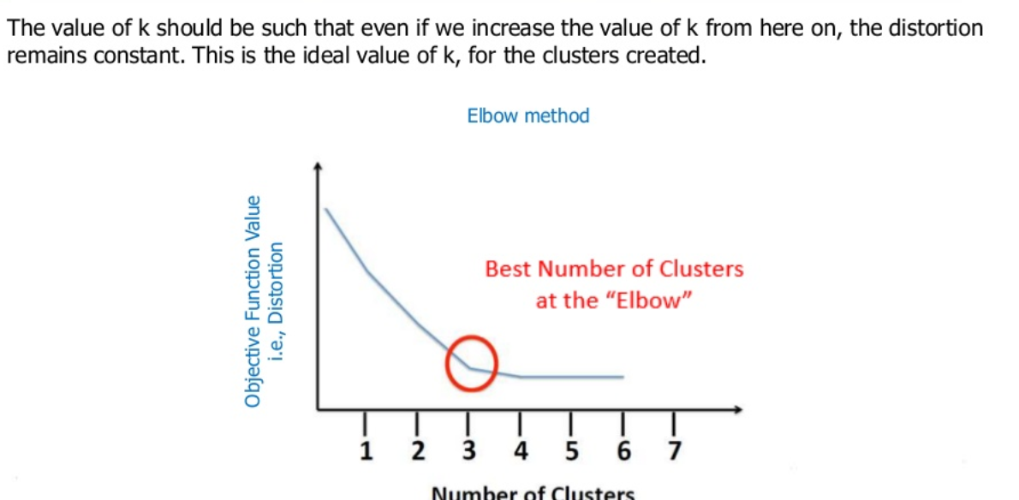
The Elbow Curve

Slide 27
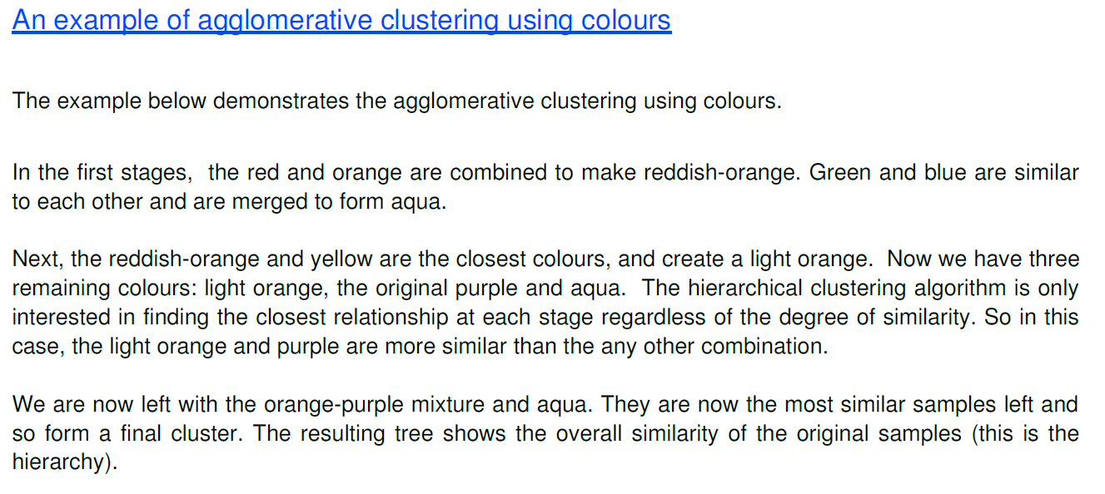
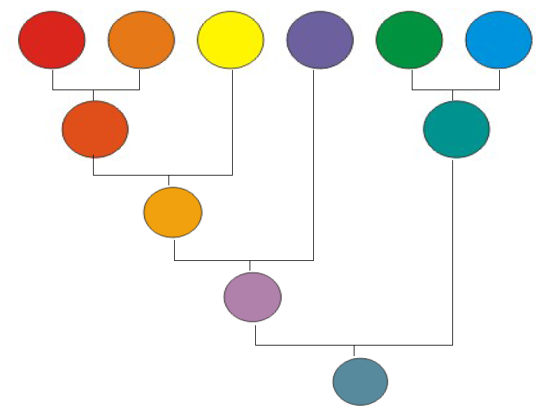
Hierarchical Clustering

Slide 28
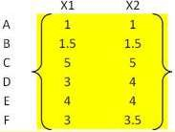
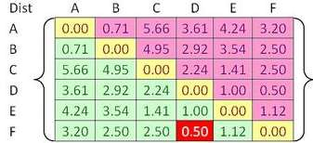
Hierarchical Clustering…Contd.
Assume that there are have 6 objects namely A, B, C, D, E and F and each object have two measured features X1 and X2.
Use Euclidean distance to compute the distance between objects.
dist ((x, y), (a, b)) = √(x - a)² + (y - b)²
Example,
Distance between object A = (1, 1) and B = (1.5, 1.5) can be computed dist ((1, 1), (1.5,1.5 )) = √(1 – 1.5)² + (1 – 1.5)²
Similarly, when we calculate the distance for other objects, will get the below matrix

Slide 29
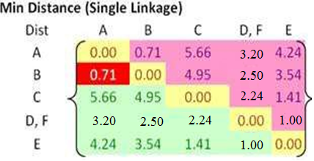
Hierarchical Clustering…Contd.
Further to group different groups following step is followed
In each step of the iteration, find the closest pair clusters.
In this case, the closest cluster is between cluster F and D with shortest distance of 0.5.
So we can group cluster D and F into cluster (D, F).
(D,F) is the first cluster formed . Then update the distance matrix as shown below , based on the newly formed cluster .
Distance between cluster (D,F) with other groups are found in below process and reflected in below matrix
Use the input distance matrix to calculate distance between cluster C and cluster (D, F).
The above distance equation is further explained as follows

Slide 30
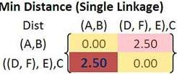
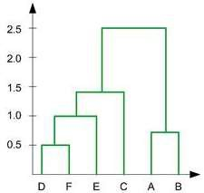
Hierarchical Clustering…Contd.
The process continues and the last, merge cluster ((D, F), E) and cluster C into a new cluster name (((D,F), E), C).
The dendogram is drawn based on the distances to merge the clusters

Slide 31
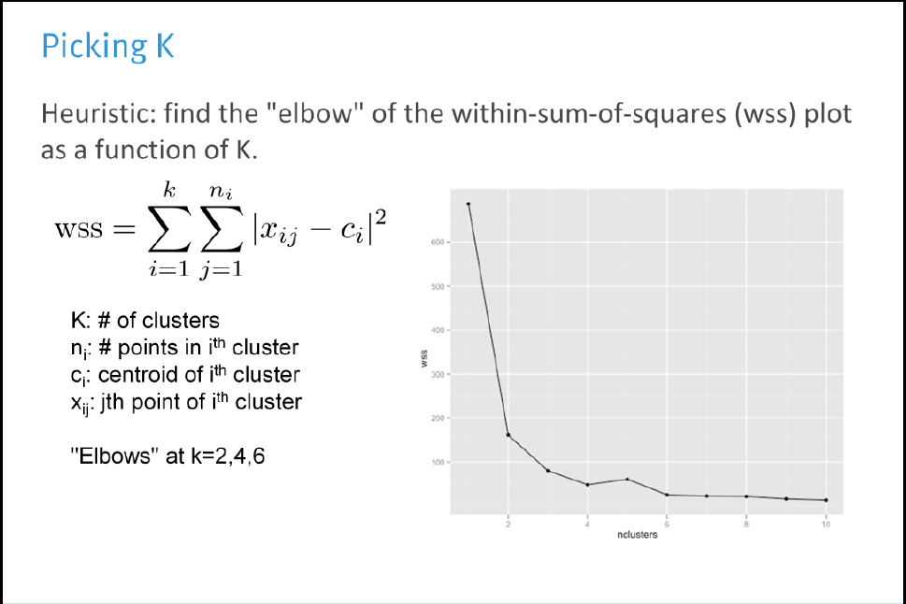
Picking -K

Slide 32
Cluster-Closure
Importance & Diagnostic

Slide 33
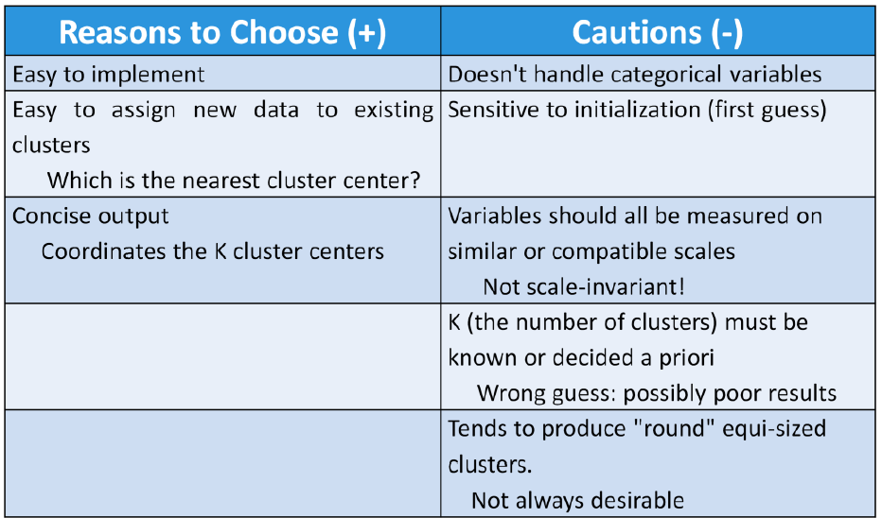
Cluster – “+” & “-” Points

Slide 34
MBA
Market Basket Analysis

Slide 35
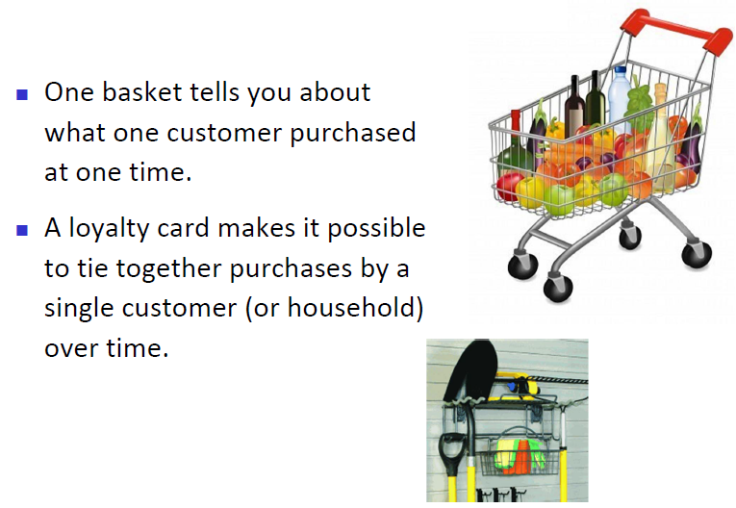
Market Basket Analysis
Ref :http://paginas.fe.up.pt/~ec/files_1112/week_04_Association.pdf

Slide 36
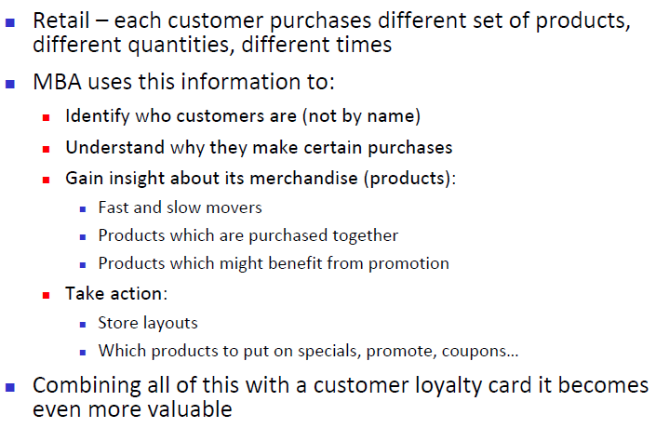
Market Basket Analysis …Contd.
Ref :http://paginas.fe.up.pt/~ec/files_1112/week_04_Association.pdf

Slide 37
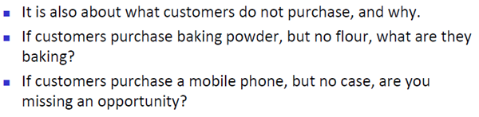
What is More ?
More than just the content of Shopping carts
Ref :http://paginas.fe.up.pt/~ec/files_1112/week_04_Association.pdf

Slide 38
Market Basket Analysis and Association Rules
Market Basket Analysis is one of the key techniques used by large retailers to uncover associations between items. It works by looking for combinations of items that occur together frequently in transactions. To put it another way, it allows retailers to identify relationships between the items that people buy.
Association Rules are widely used to analyze retail basket or transaction data, and are intended to identify strong rules discovered in transaction data using measures of interestingness, based on the concept of strong rules.

Slide 39
MBA
Association Rule

Slide 40
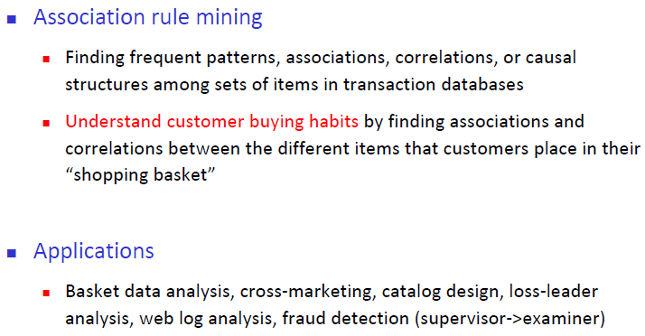
Association Rule
Ref :http://paginas.fe.up.pt/~ec/files_1112/week_04_Association.pdf

Slide 41
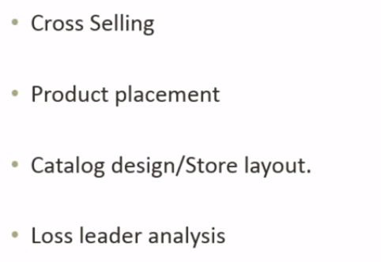
Applications

Slide 42
Applications
Market Basket Analysis: given a database of customer transactions, where each transaction is a set of items the goal is to find groups of items which are frequently purchased together.
Telecommunication (each customer is a transaction containing the set of phone calls)
Credit Cards/ Banking Services (each card/account is a transaction containing the set of customer’s payments)
Medical Treatments (each patient is represented as a transaction containing the ordered set of diseases)
Basketball-Game Analysis (each game is represented as a transaction containing the ordered set of ball passes)

Slide 43
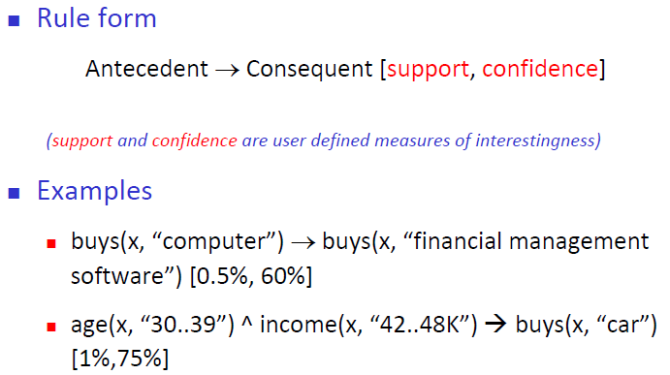
What is Association Rule
Ref :http://paginas.fe.up.pt/~ec/files_1112/week_04_Association.pdf

Slide 44
Association Rule… Continued
Association rules are normally written like this: {Diapers} -> {Beer} which means that there is a strong relationship between customers that purchased diapers and also purchased beer in the same transaction.
In the above example, the {Diaper} is the antecedent and the {Beer} is the consequent.
Both antecedents and consequents can have multiple items. In other words, {Diaper, Gum} -> {Beer, Chips} is a valid rule.
Support is the relative frequency that the rules show up. In many instances, you may want to look for high support in order to make sure it is a useful relationship. However, there may be instances where a low support is useful if you are trying to find “hidden” relationships.

Slide 45
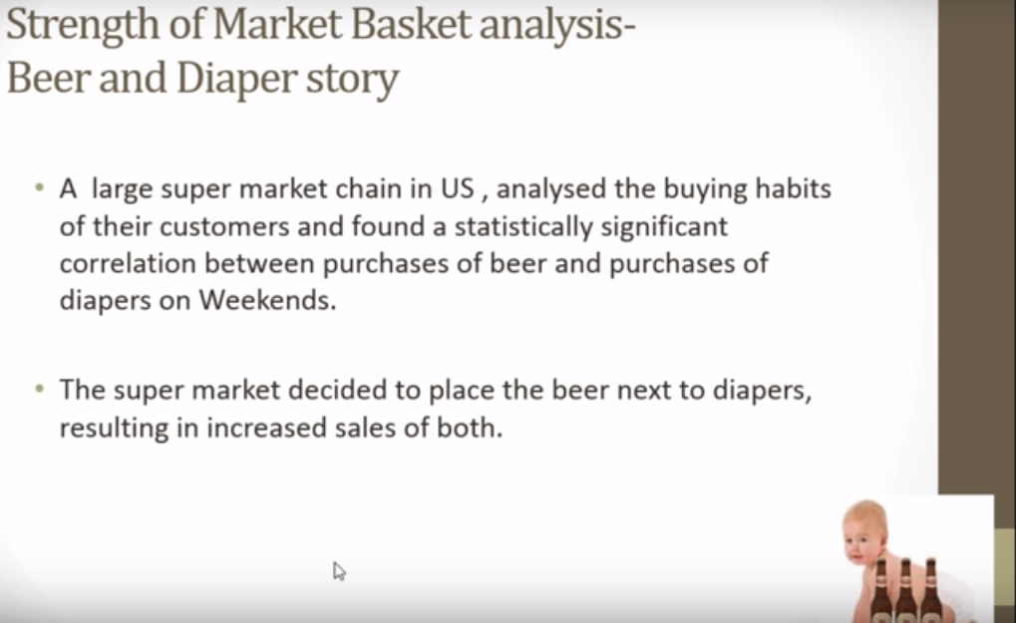
How Association Rule Used ?
Ref :http://paginas.fe.up.pt/~ec/files_1112/week_04_Association.pdf

Slide 46
MBA
Apriori Algorithm

Slide 47
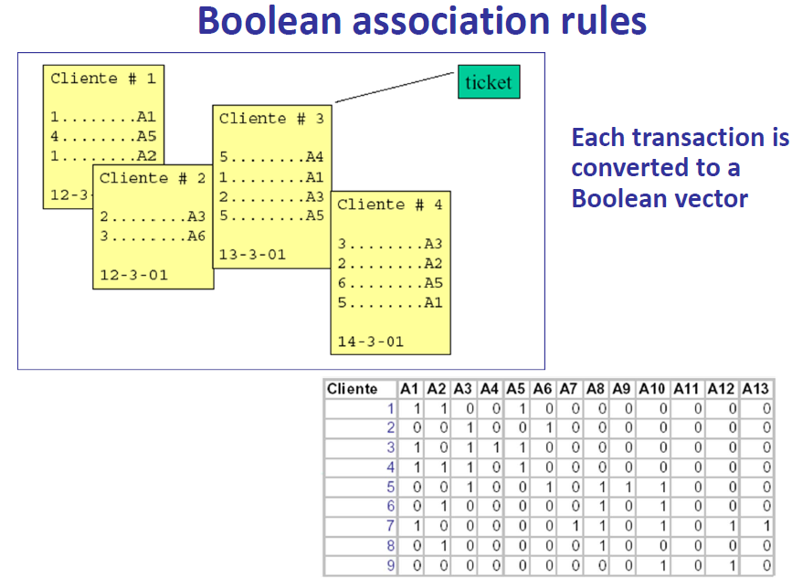
Apriori Algorithm
Ref :http://paginas.fe.up.pt/~ec/files_1112/week_04_Association.pdf

Slide 48
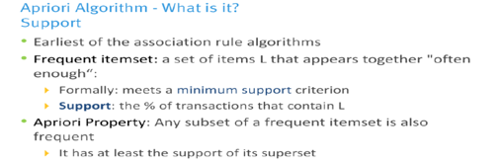
Apriori Algorithm

Slide 49
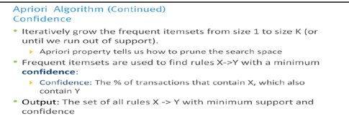
Apriori Algorithm

Slide 50
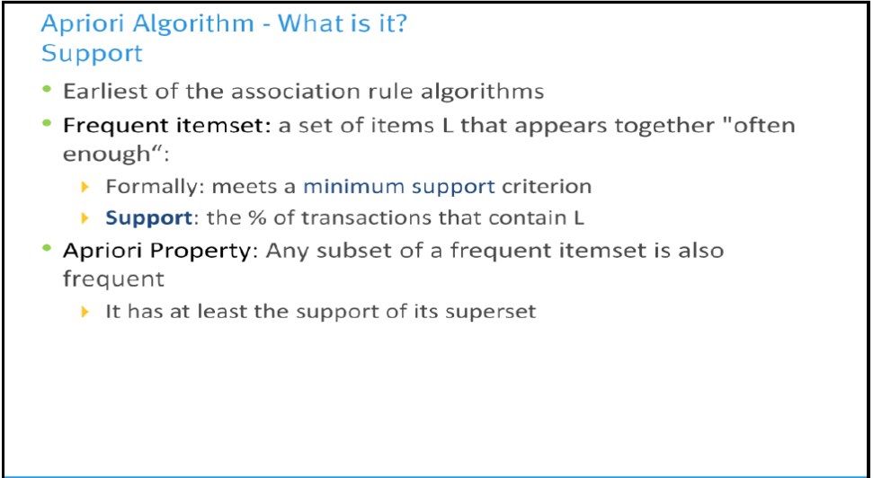
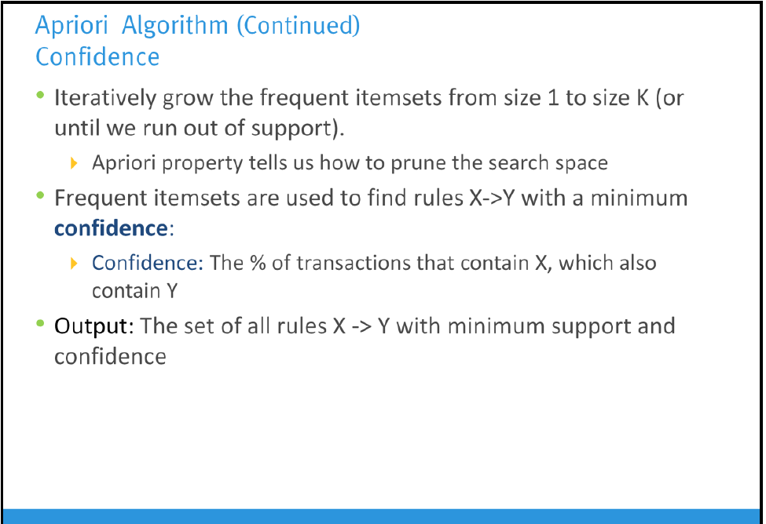
Apriori Algorithm …Contd.
Lift and Leverage.
Lift measures how many times more often X and Y occur together than expected if they were statistically independent. It is a measure of how X and Y are really related rather than coincidentally happening together.
Leverage is a similar notion but instead of a ratio it is the difference.
Leverage measures the difference in the probability of X and Y appearing together in the data set compared to what would be expected if X and Y were statistically independent.

Slide 51
Apriori Algorithm …Contd.
Support is the relative frequency that the rules show up. In many instances, you may want to look for high support in order to make sure it is a useful relationship. However, there may be instances where a low support is useful if you are trying to find “hidden” relationships.
Confidence is a measure of the reliability of the rule. A confidence of .5 in the above example would mean that in 50% of the cases where Diaper and Gum were purchased, the purchase also included Beer and Chips. For product recommendation, a 50% confidence may be perfectly acceptable but in a medical situation, this level may not be high enough.
Lift is the ratio of the observed support to that expected if the two rules were independent (see wikipedia). The basic rule of thumb is that a lift value close to 1 means the rules were completely independent. Lift values > 1 are generally more “interesting” and could be indicative of a useful rule pattern.

Slide 52
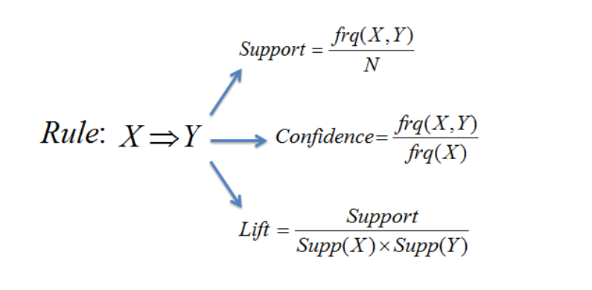
Apriori Algorithm …Contd.

Slide 53
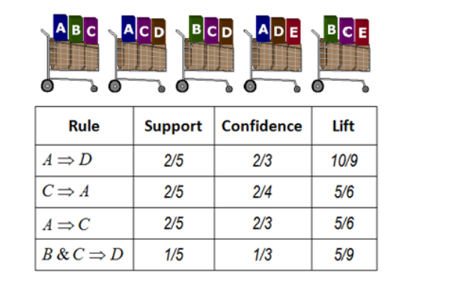
Example :1

Slide 54
Example 2:
Assume there are 100 customers
10 of them bought milk, 8 bought butter and 6 bought both of them.
bought milk => bought butter
support = P(Milk & Butter) = 6/100 = 0.06
confidence = support/P(Butter) = 0.06/0.08 = 0.75
lift = confidence/P(Milk) = 0.75/0.10 = 7.5

Slide 55
The Apriori Algorithm — Example
Min support =50%
Database D
L₁
C₁
Scan D
C₂
C₂
L₂
Scan D
C₃
Scan D
L₃

Slide 56
MBA-Closure
Importance & Diagnostic

Slide 57
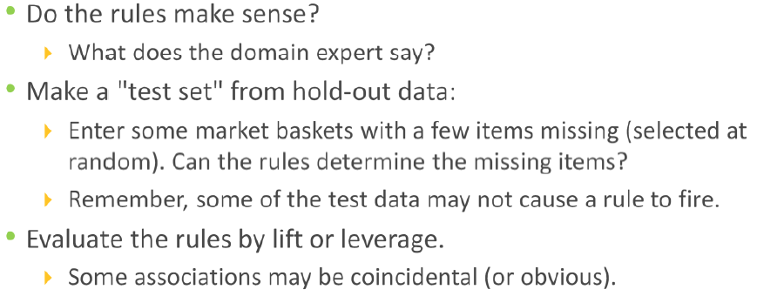
MBA- Diagnostics

Slide 58
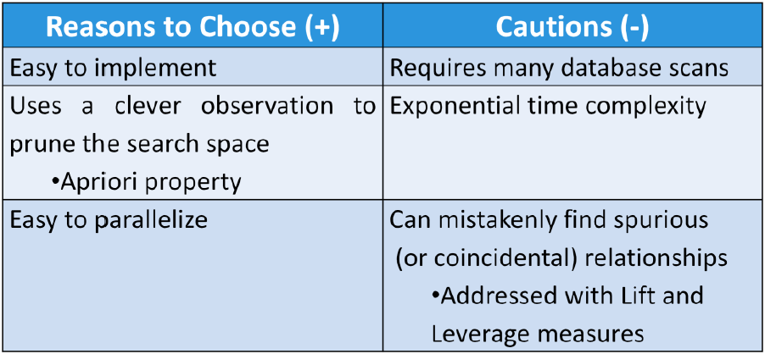
MBA – Positive & Negative Points

